Slide 1
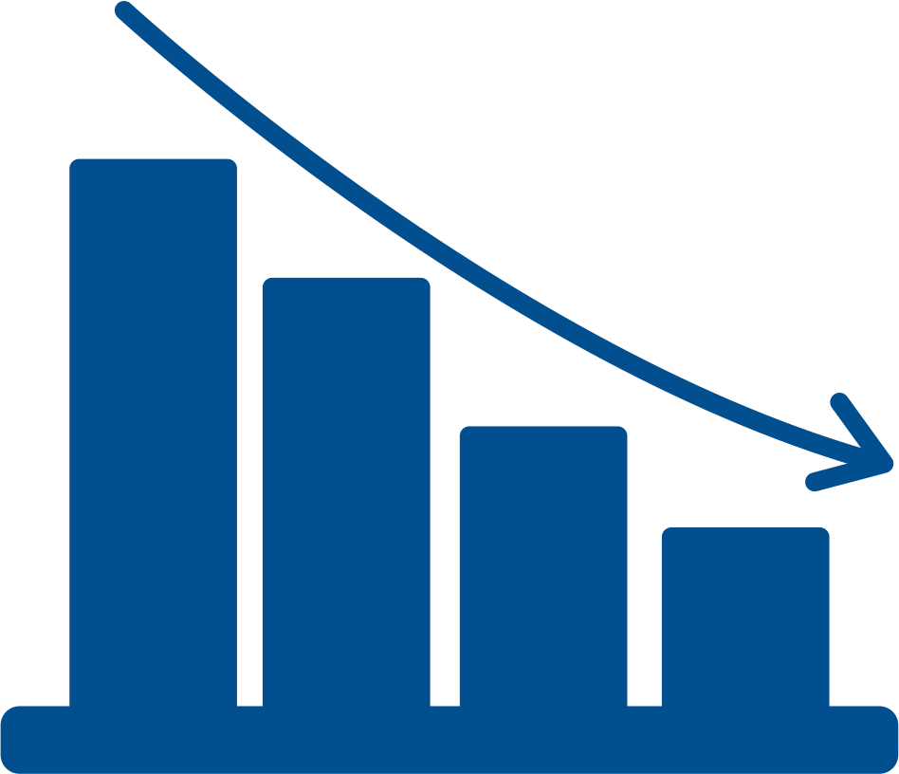
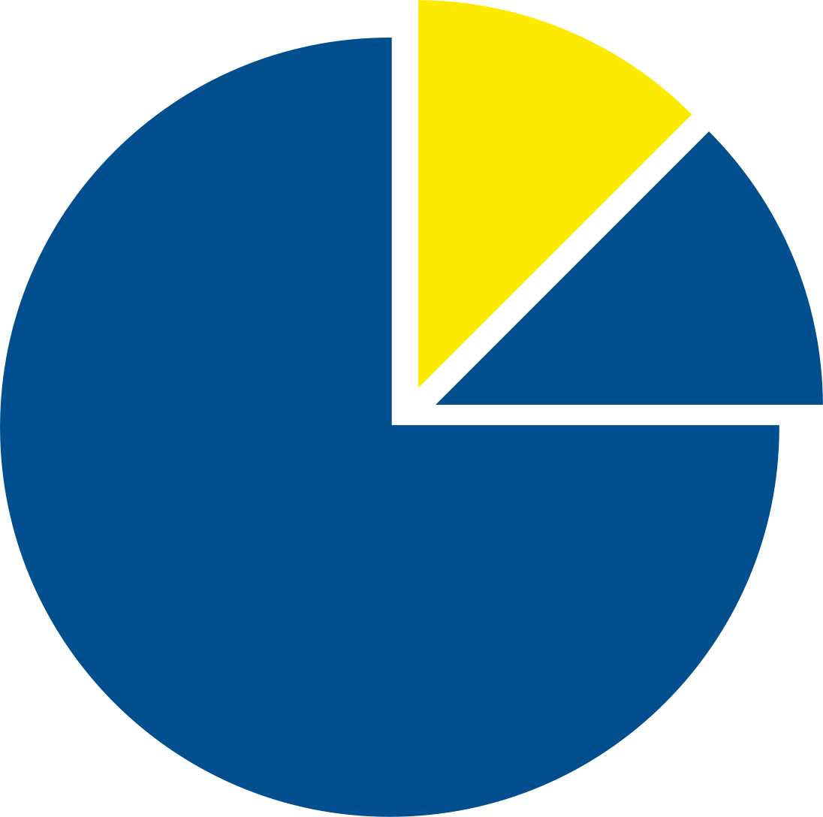
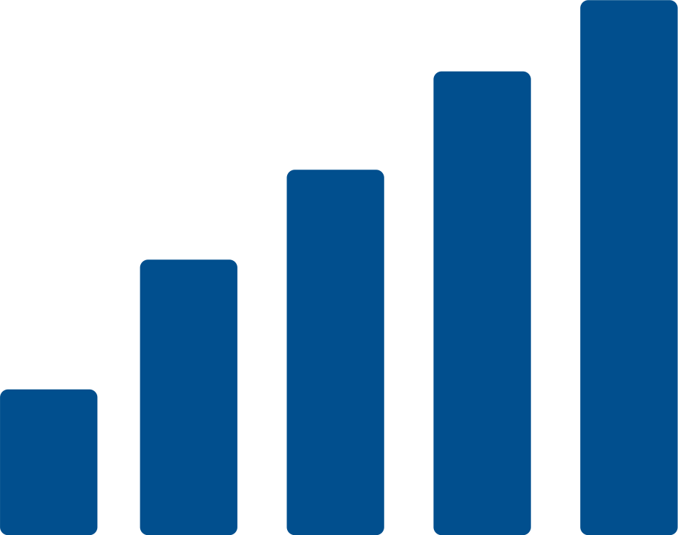


Using Better Visualisations to Elevate Your Data Insights
Mansi Aggarwal | WWCode Dev Summit: BlockDataPy | 2023

Slide 2

Hi, I am Mansi! 👋
🙋‍♀️ 2022-23 Fellow @ WWCode Data Science
👩‍💻 Junior Data Scientist @ Longview, Melbourne
👩‍🎓Masters student at Monash University
🧬 Interested in bioinformatics and started working on my master's thesis project in melanoma research this semester
📺 Avid sitcom enthusiast

Slide 3
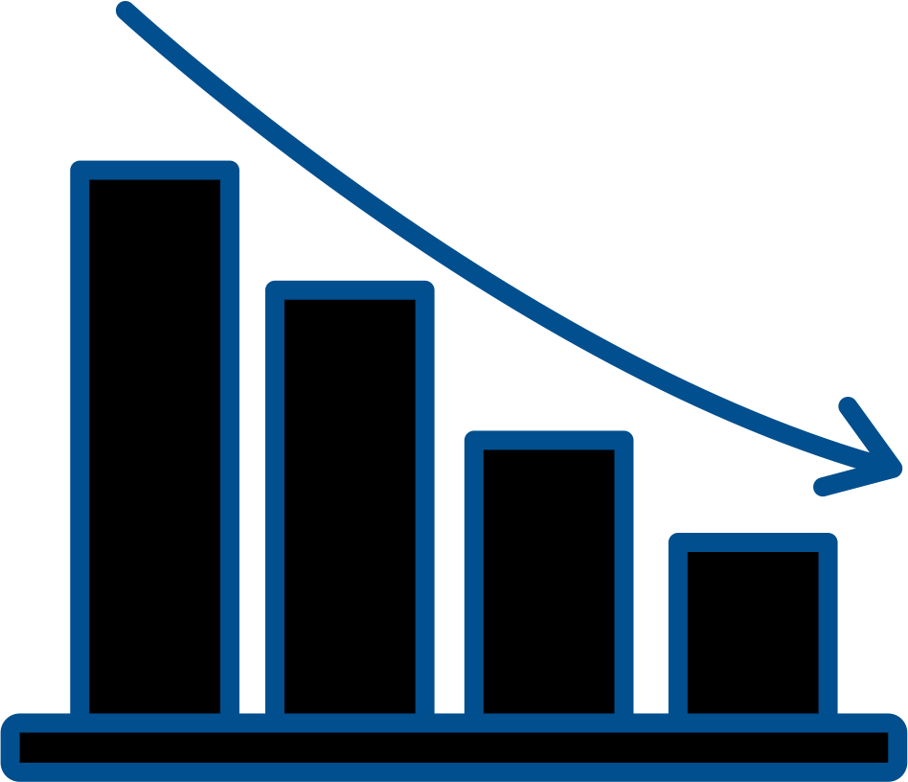

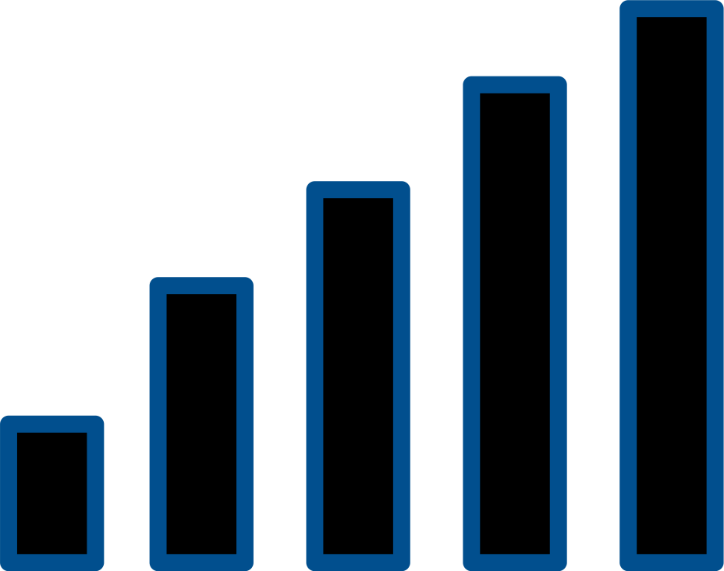

Why visualisation?
What are the pillars of good visual storytelling?
AGENDA
How to improve a standard chart?
How do we derive deeper insights using visualisations?

Slide 4
Why visualisation?

Slide 5
Detect anomalies and outliers
Enhanced comprehension
Uncover patterns and trends
Improved decision-making
Effective communication
Support storytelling

Slide 6
Four pillars of good visual storytelling

Slide 7


Why am I creating this visualization?
Who is it for?
What do they need to understand?
What actions do I need to enable?
What is the most important take-away message?
PURPOSE

Slide 8
• Informed by purpose!
What data matters?
• What's excluded is as important as what's included.
CONTENT
PURPOSE

Slide 9
Bars for comparison
Line charts for time, continuity
Stacked bar charts, pie charts for composition
Scatter plots for correlation
Heatmaps for volume of locations/events
STRUCTURE
CONTENT
PURPOSE

Slide 10
FORMATTING
Helps highlight what's important
Adds appeal and focus
Just like icing on a cake!
STRUCTURE
CONTENT
PURPOSE

Slide 11
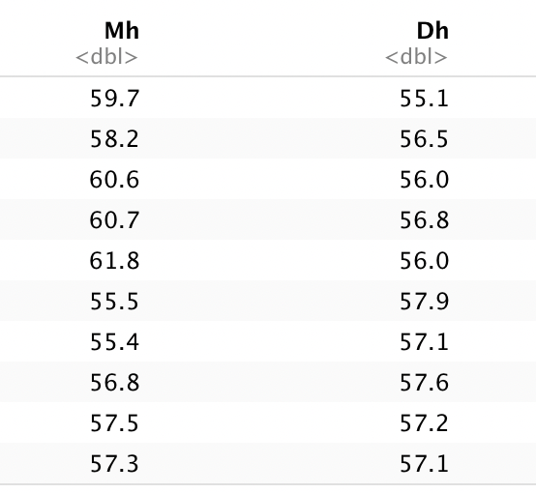
Raw data hardly conveys useful information

Slide 12
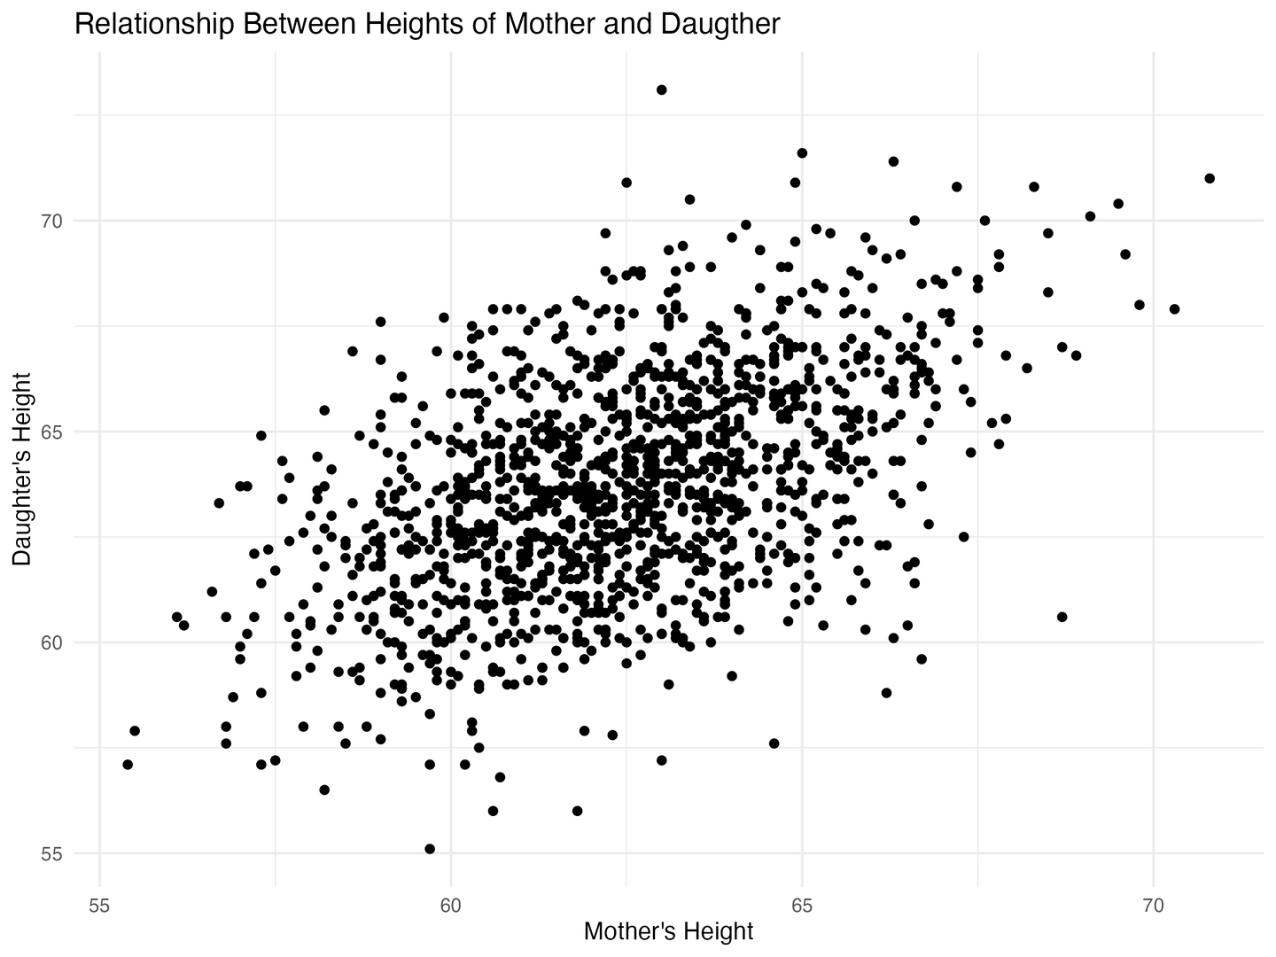
Good visualisations make information accessible
We now know that
this data has two variables - mothers' heights and daughters' heights
there is a strong positive relationship between the two

Slide 13
But how to improve a standard chart?

Slide 14
But how to improve a standard chart?
Less is more - start simple!
Use clear labels, titles (and subtitles)
Customise your charts - using non-default colours and settings
Emphasise key information
Test for accessibility
Seek feedback

Slide 15
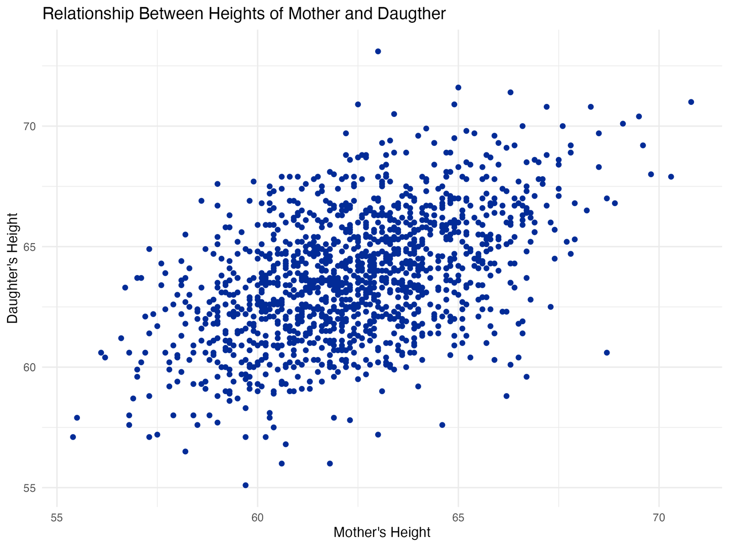
Non-default colour

Slide 16
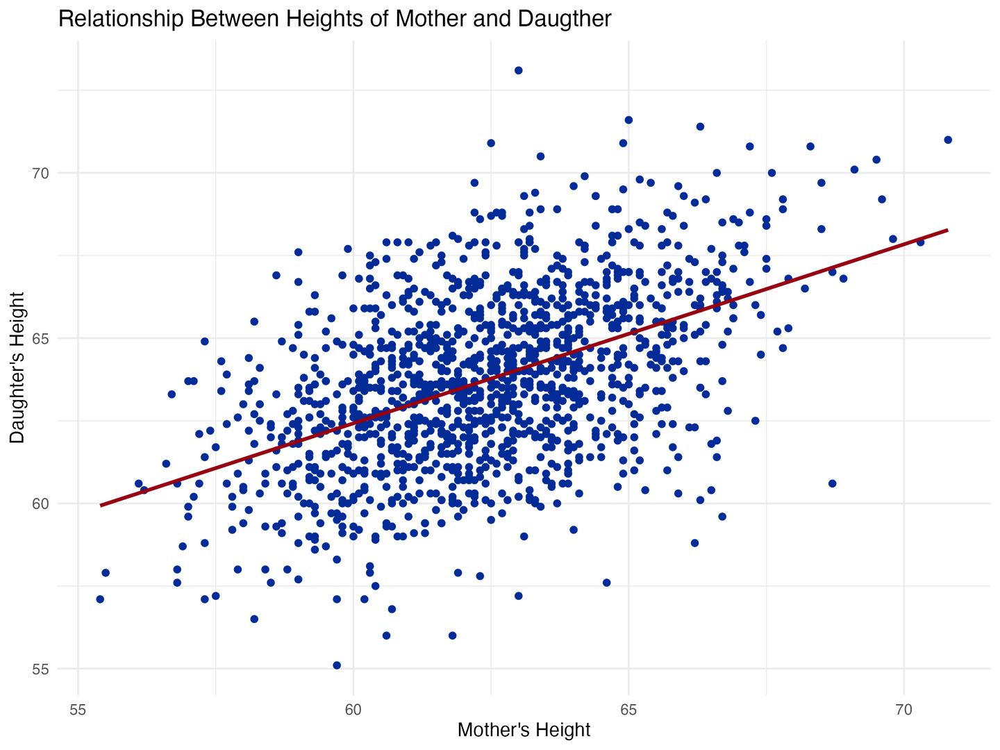
Non-default colour
Emphasising key information - a strong positive relationship between our two variable

Slide 17
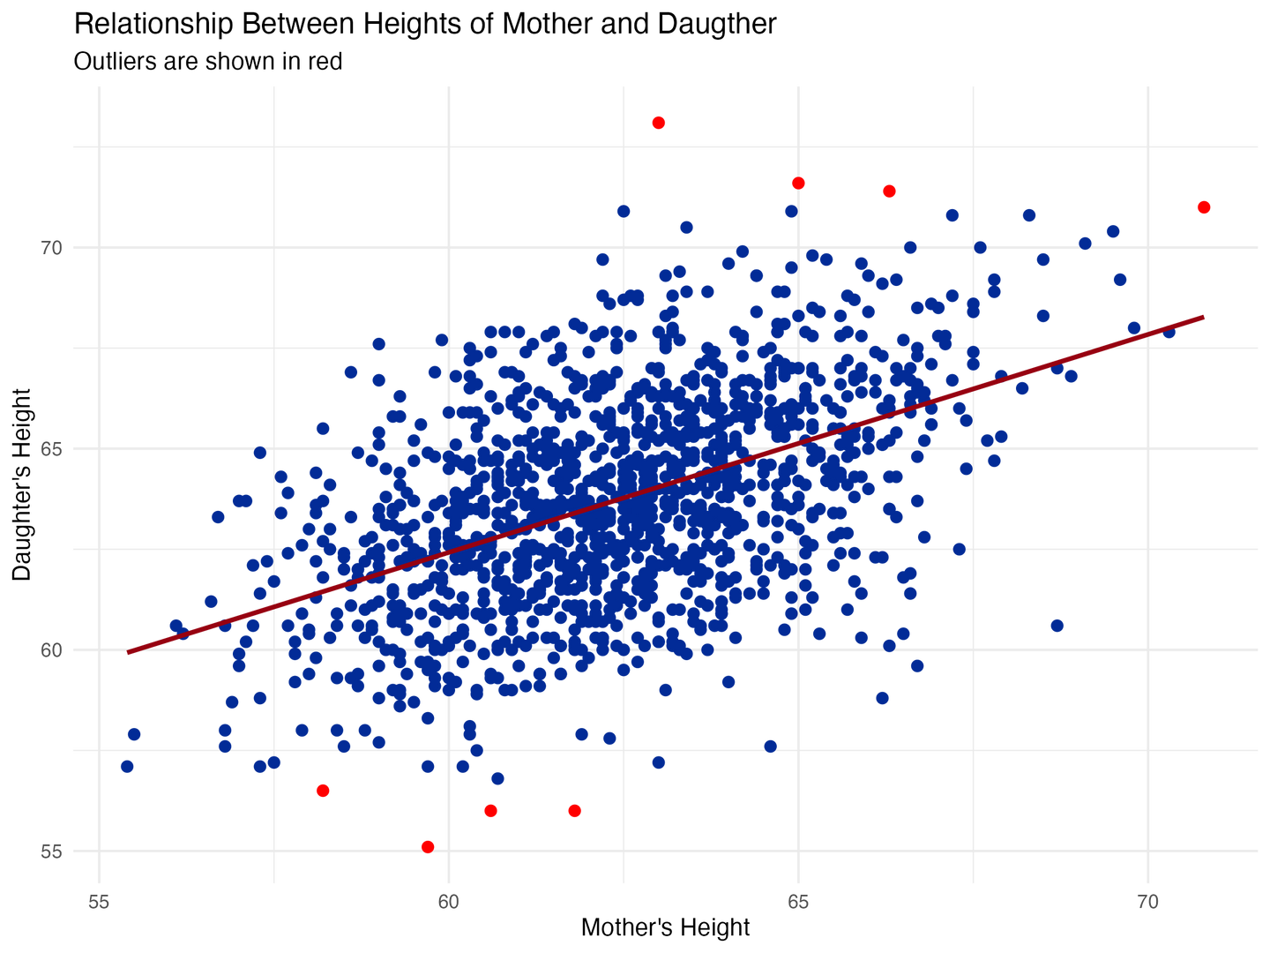
Non-default colour
Emphasising key information - a strong positive relationship between our two variable
Sprucing it up - showing outliers in a different colour!

Slide 18
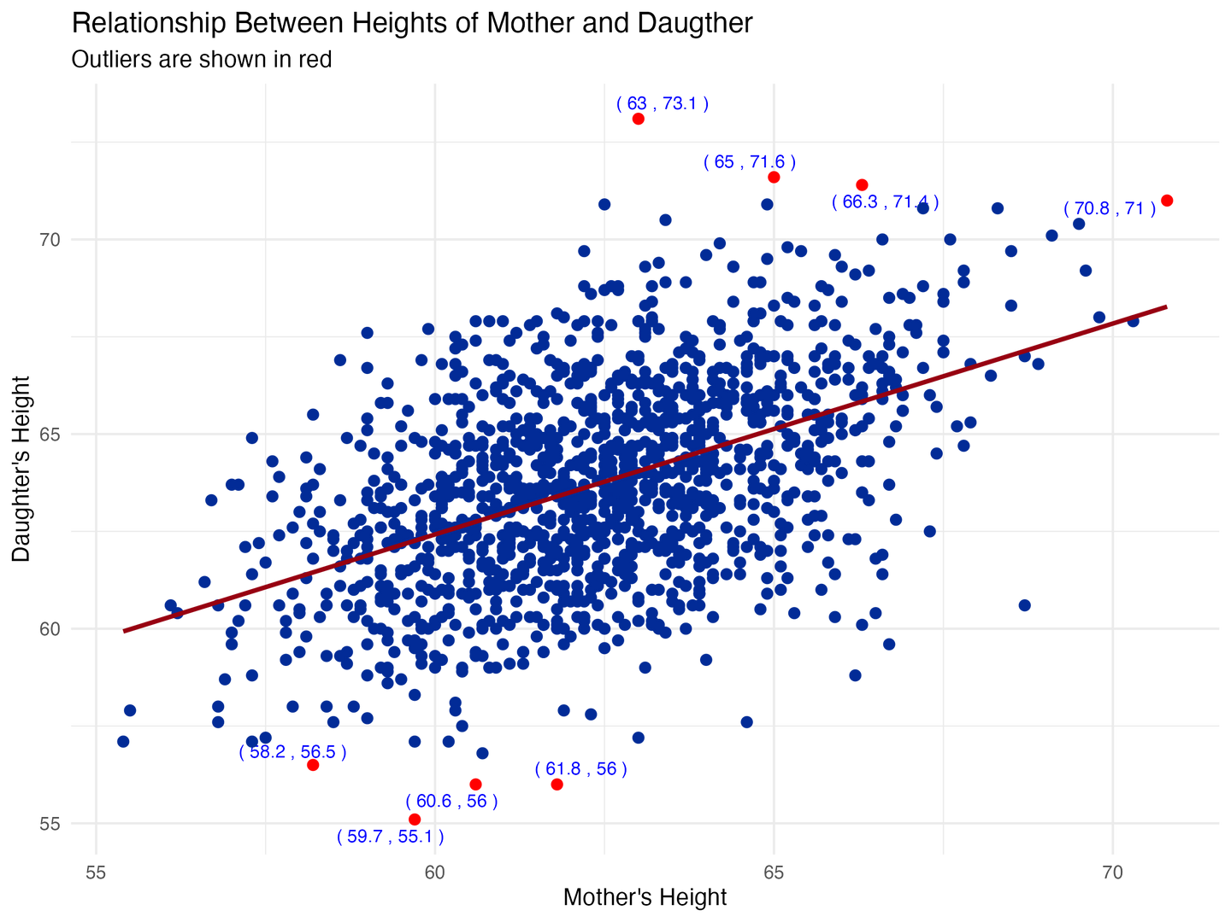
Start small and work your way up, and always have a backup plan!
If you have more time - tinker with your baseline charts. Here, I annotated the outliers with the x and y coordinates

Slide 19

How do we derive deeper insights using visualisations?
We are going to look at an example from the world of bioinformatics!
You do not have to be an expert to follow this - just see this from a lens of how different visualisations can offer meaningful insights which might otherwise be hard to decipher from large tables!

Slide 20

What exactly will we be looking at?
My report aimed to provide a thorough review of the 2020 Nature article by Bojkova et al. titled "SARS- CoV-2 Infected Host Cell Proteomics Reveal Potential Therapy Targets" and understanding the molecular interactions between the virus and host cells is crucial for developing effective therapeutic strategies.

Slide 21

Things to remember as we move forward?
Don't focus on understanding the meaning of the biological terms being used - take everything at face value!
For instance, upregulation means "increase in the state of something" and downregulation means "decrease in the state". "Significant" means "p-value less than 0.05"!

Slide 22

Our dataset
We monitored host cell response to infection at various periods – 2, 6, 10, and 24 hours – following infection and studied 2,715 significant proteins.

Slide 23
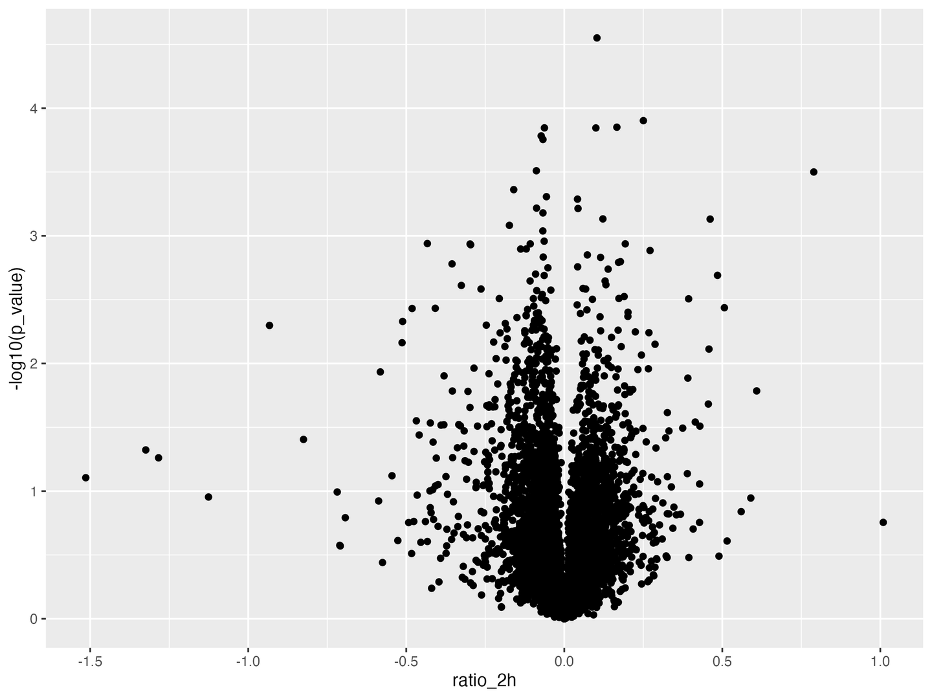
This was my starting point - I plotted all 2715 proteins with their p-value on the y-axis and ratio at the 2-hour time point on the x-axis!

Slide 24
This was my starting point - I plotted all 2715 proteins with their p-value on the y-axis and ratio at the 2-hour time point on the x-axis!
What is going on?

Slide 25
We clearly need to amp
this up!

Slide 26
We clearly need to amp
this up!
What information do we have?
Ratio - negative says downregulation and positive ratio means upregulation!
p-value - metric for statistical significance
Gene symbol - allows for clear and unambiguous reference to genes
Use information to your advantage!

Slide 27
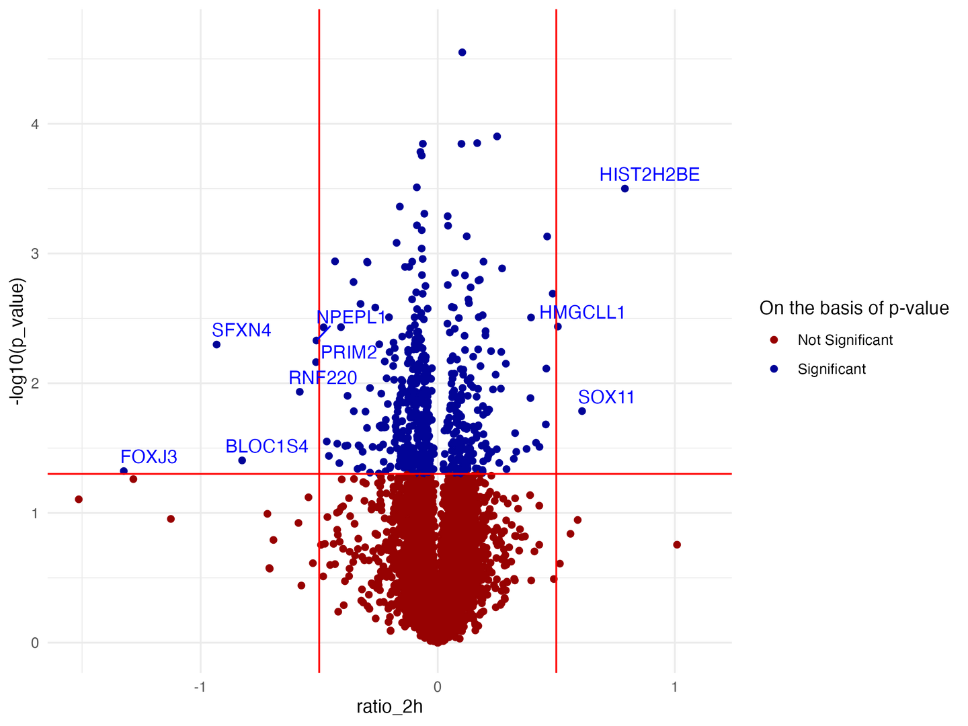
We just translated all key information in the form of a visualisation!

Slide 28

We just translated all key information in the form of a visualisation!
A threshold of 0.05 set for p-value to distinguish between significant and not significant proteins!

Slide 29
We just translated all key information in the form of a visualisation!
Proteins with ratio above 0.5 and below -0.5 were considered upregulated and downregulated respectively

Slide 30
We just translated all key information in the form of a visualisation!
Significant proteins were sorted in ascending order based on p-value to get the top 10 proteins - which have been annotated!

Slide 31
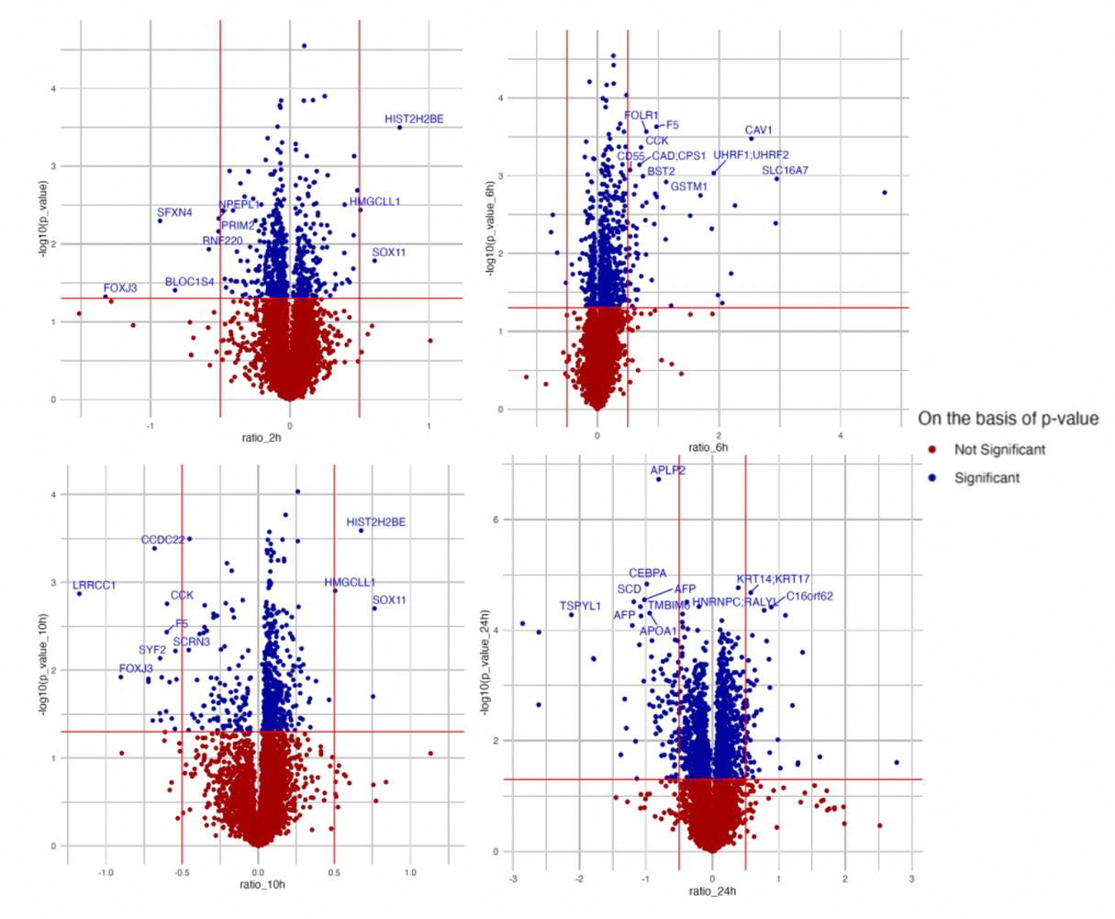
When we performed the same process for proteins at all time points, we saw that the significant proteins are not common across the four time points.
And hence, we chose to investigate the significant proteins at 24h to understand later stages of infection.

Slide 32
The same information can be conveyed in different formats!

Slide 33
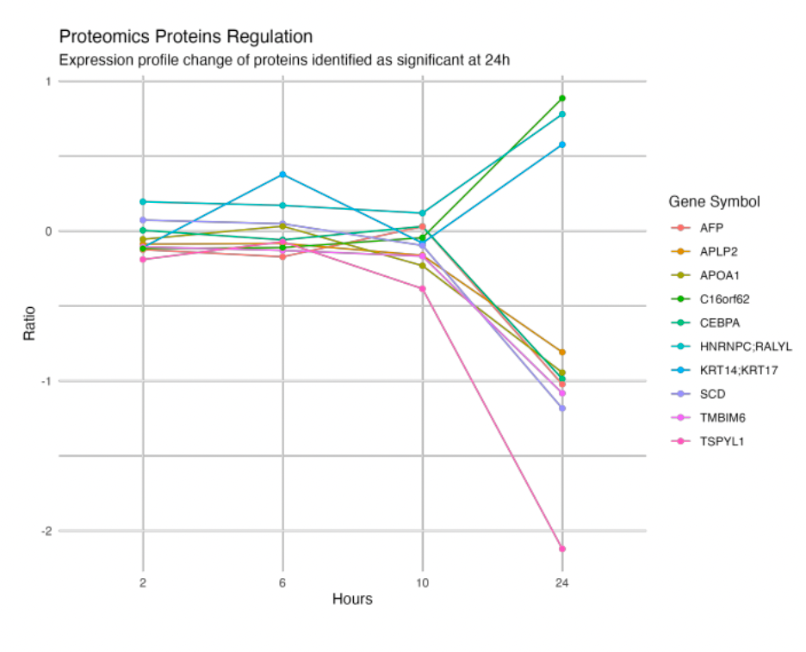
For example - studying how significant proteins at the 24h time point changed over previous hours
- in the form a line plot!

Slide 34
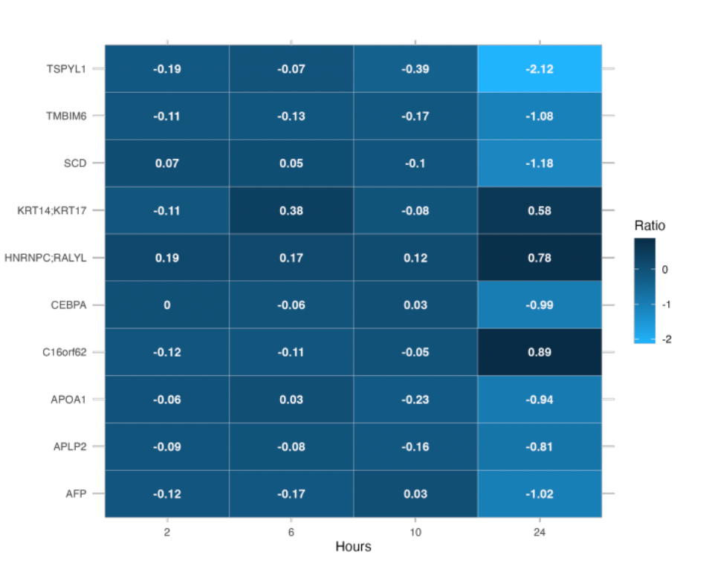
Or a heatmap!

Slide 35
Purpose is key - you need to have a clear idea of what you need to convey/represent
Start small and then increase complexity - and always have a backup plan!
Focus on mastering one visualisation tool and then dabble with more
Experiment with colours, annotations, chart types.
Practice making complex and interactive visualtions!
Conclusions

Slide 36
Resources
TidyTuesday Project: TidyTuesday is a weekly social data project. All are welcome to participate!
From Data to Viz: an excellent repository of chart types based on input data format which comes in the form of a decision tree leading to a set of potentially appropriate visualizations to represent the dataset.
A ggplot2 Tutorial for Beautiful Plotting in R by Cedric Scherer: An extensive tutorial containing a general introduction to ggplot2 as well as many examples of how to modify a ggplot, step by step.
#30DayChartChallenge: A community-driven event with the goal to create a data visualization on a certain topic each day of April.

Slide 37

Thank you!

